Slide 1
Order Entry App
Application Template Specification

Slide 2
Overview
Our aim is to create reusable application templates for developers. Right now we are focusing on order entry application for busy small business owners. This project is to build general template for the regular structure of order entry application.
We received these screens as references with support of PointOS company.
PointOS company web-site: https://pointos.com

Slide 3
Required Experience
Embarcadero Delphi 10.3 Rio.
The FireMonkey cross-platform application framework for Android and iOS development.
POS-systems best practices with proper user interface and user experience.
Easy developer customization and deployment

Slide 4
Specifics
Specifically we are working on something similar to general existing order entry applications.
The goal is to have a reusable template that a user can download and add their own content to and create a professional looking application.
The template will be delivered in a sample application that shows the power and flexibility of the template, and that is documented enough so that a user will understand how to customize it for their use. On the following slides you will find screenshots and annotations

Slide 5
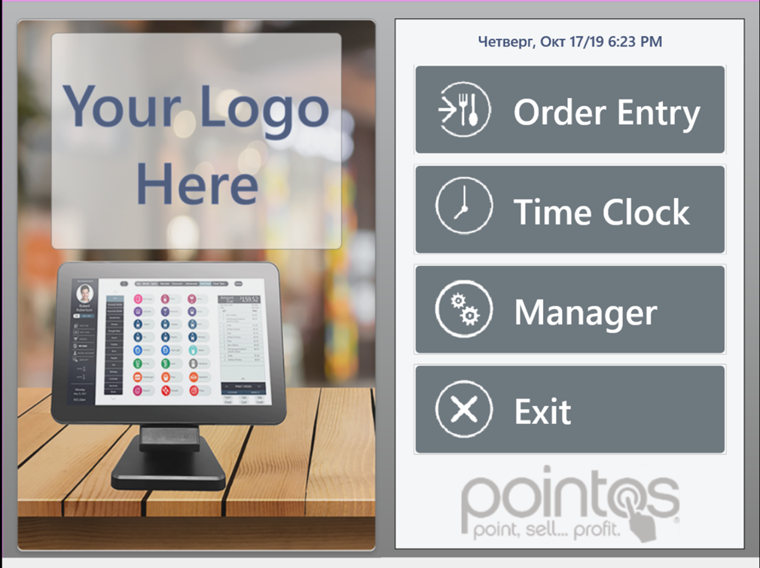
Dashboard screen
Logo place
Date
Order Entry – tabs, rooms and menu management.
Time Clock – employee clock in/clock out.
Manager – main manager settings.
Exit – exit from the application

Slide 6
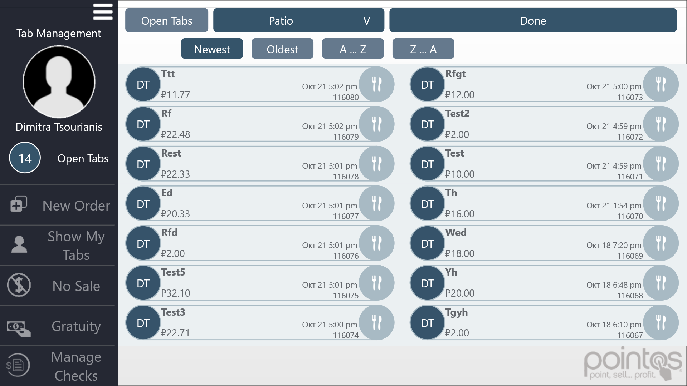
Tabs Management
Shows open tabs with orders
Rooms with tables
Returns to the dashboard
Order information: name of the employee; name\number\type of the order, date
Sorts tabs
V
V
Shows an amount of tabs
Victoria
V
V
V
V
Creates a new order
V
V
Shows user tabs
V
V
Opens a cash drawer
V
V
Adjusts gratuity
V
V
Option to manage checks

Slide 7
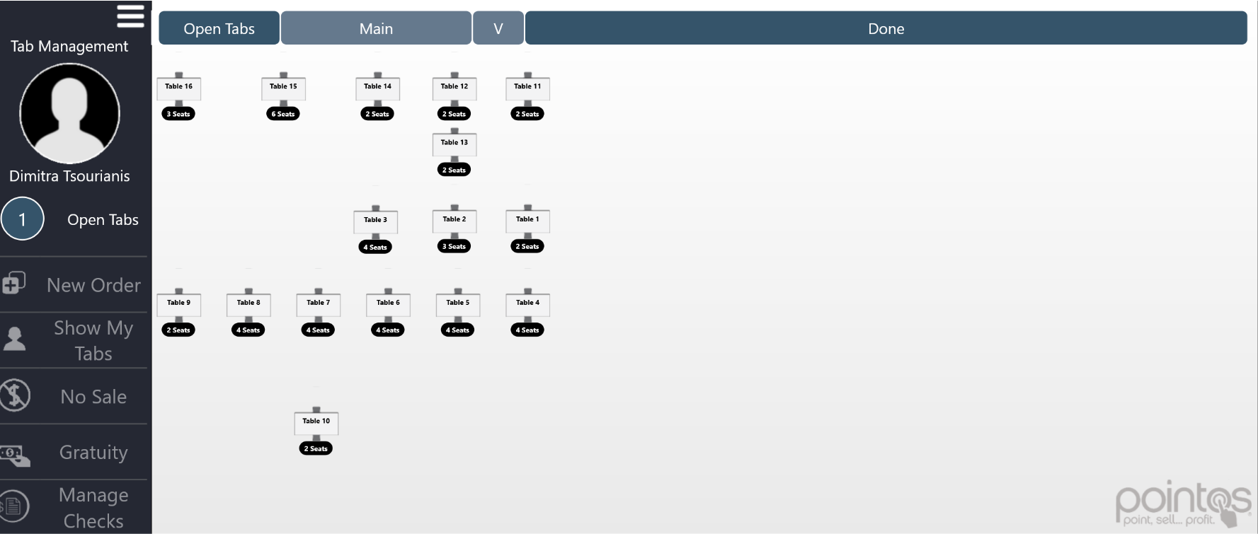
Room management
In a room view it is possible to assign a table to a user and to start a new tab.
It is possible to move tables on the screen according to their real location.
It is possible to see amount of seats for each table
Victoria

Slide 8
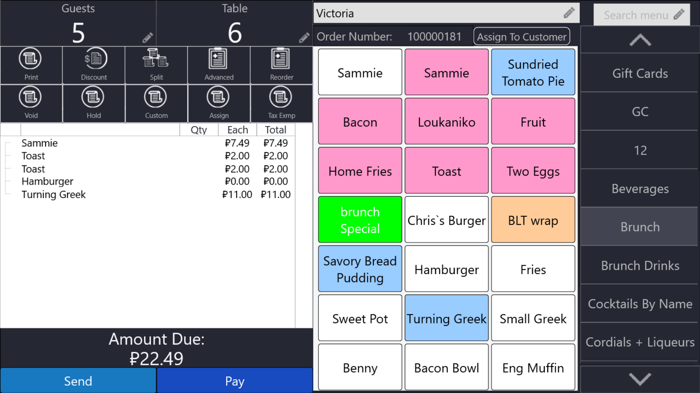
Menu and order
Options to change menu item or the whole order
Menu includes:
categories,
items,
modifiers.
Each item has a picture/color, name, information, price and ability to add it to the cart.
When user clicks on an item, there will be all detailed information about item including modifiers selection, if it is set
Sends the order to kitchen

Slide 9
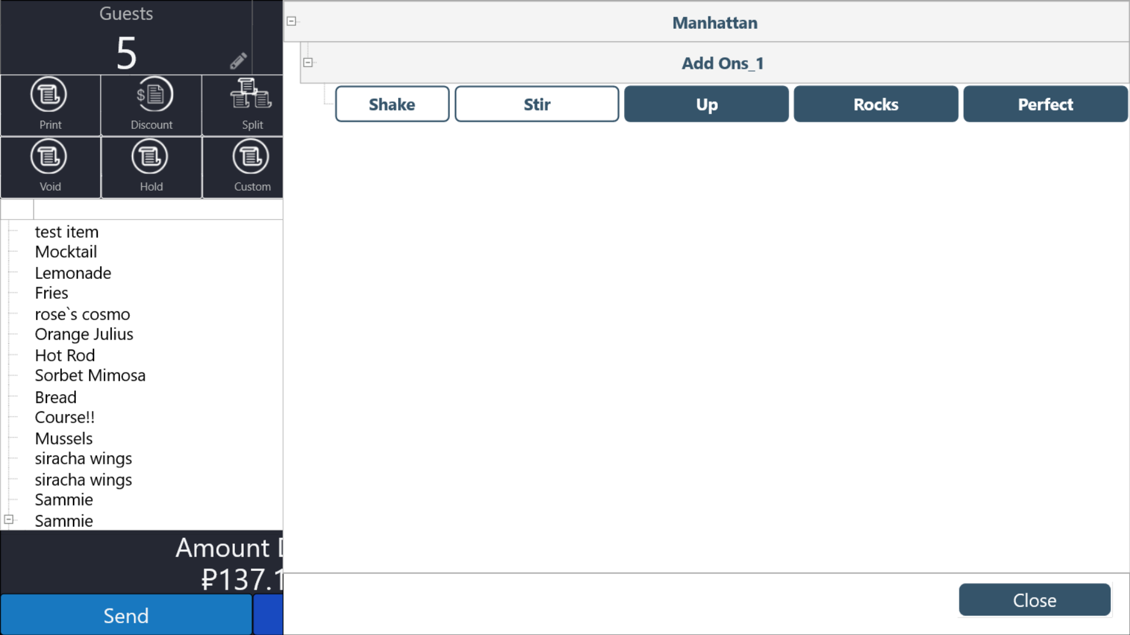
Modifiers
Modifiers screen opens for the selected item (if set).
Modifiers have groups, subgroups and items.
User can select/deselect several modifier items for the menu item

Slide 10
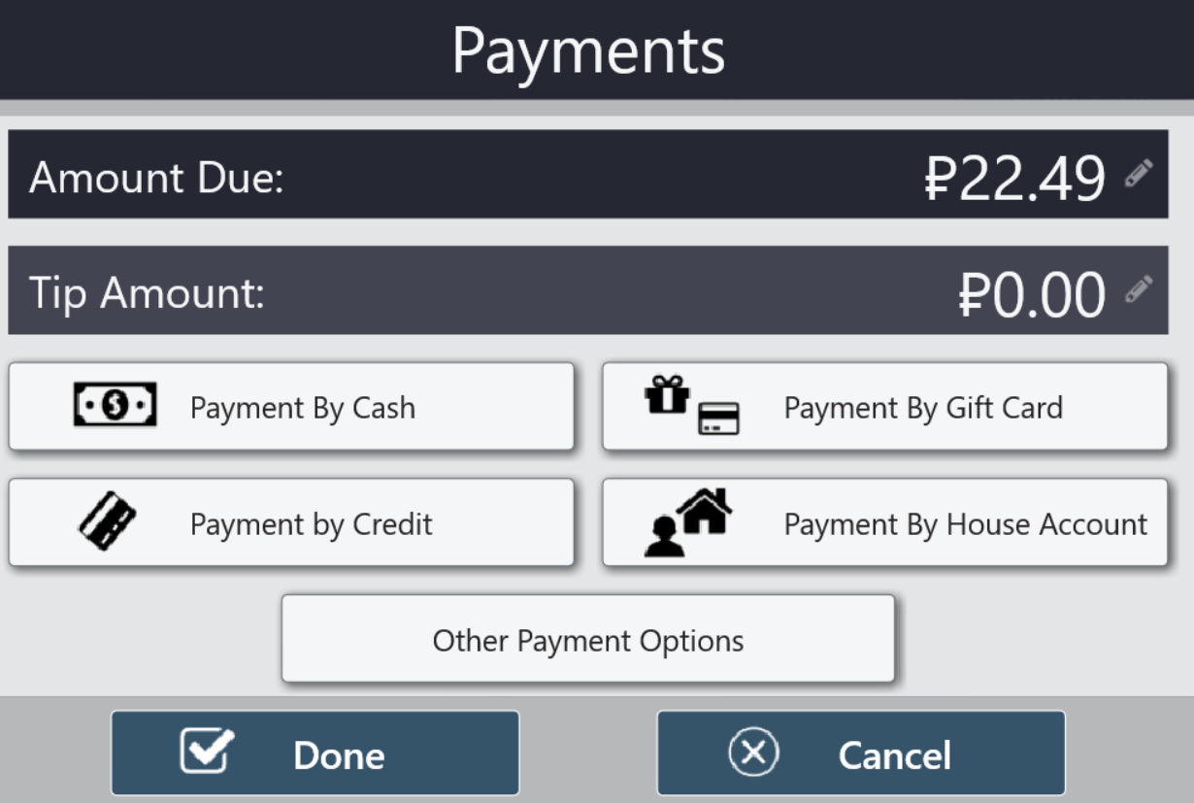
Payment types
On this screen user is able to pay for the order in different ways and leave tips

Slide 11
Requirements
Template should be created with the free Delphi 10.3 Rio Community Edition https://www.embarcadero.com/products/delphi/starter (latest update).
It should not use any 3rd party components except for those freely available via the GetIt package manager.
Any code beyond GetIt Packages or included libraries must be included with deliverable.
Include a document describing how to customize the template and the code should be well documented for easy customization.
All transitions should include proper material design animations.
Designed to work on iOS and Android, but also compatible with Windows and macOS

Slide 12
Deliverables
Reusable application template that implements order entry functionality.
Behaviors as shown.
The content within the client area is only for demonstration purposes.
A document describing how to customize the template and the code should be well documented for easy customization.
All compatible with the free Delphi 10.3 Community Edition.
Tested and designed for iOS and Android with adequate support for Windows 10 testing

